Slide 1
Neurodiversity & Networking: Bridging the Awkward Silence
Erissa Duvall

Slide 2


Agenda
Basic Terms
Legalities & Guidelines
Experience & User Feedback
Consistent Experience
Keyboards & Screen Readers
Structure & Relationships
Tools & Resources
Erissa

Slide 3
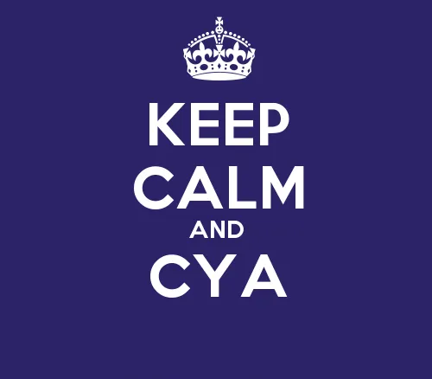
Disclaimer
I’ll pull from my professional experience, but am not officially representing any of my previous, former, or future employers.
I may mention aspects of legislation / regulations but am not an attorney / solicitor.
Erissa
Notes:
“Keep Calm and CYA” image was sourced from CYA is Killing Your Organization. I recently started working with an… | by Jennifer Cross | It's Your Turn (itsyourturnblog.com)
Image Source URL: https://itsyourturnblog.com/cya-is-killing-your-organization-c2a17e15d834

Slide 4

Ask questions!
I’m here to help you!
Erissa
Notes:
“Keep Calm and CYA” image was sourced from CYA is Killing Your Organization. I recently started working with an… | by Jennifer Cross | It's Your Turn (itsyourturnblog.com)
Image Source URL: https://itsyourturnblog.com/cya-is-killing-your-organization-c2a17e15d834
I’m here to help you!
I will also have links to resources at the end of the presentation.
So no worries about missing anything

Slide 5
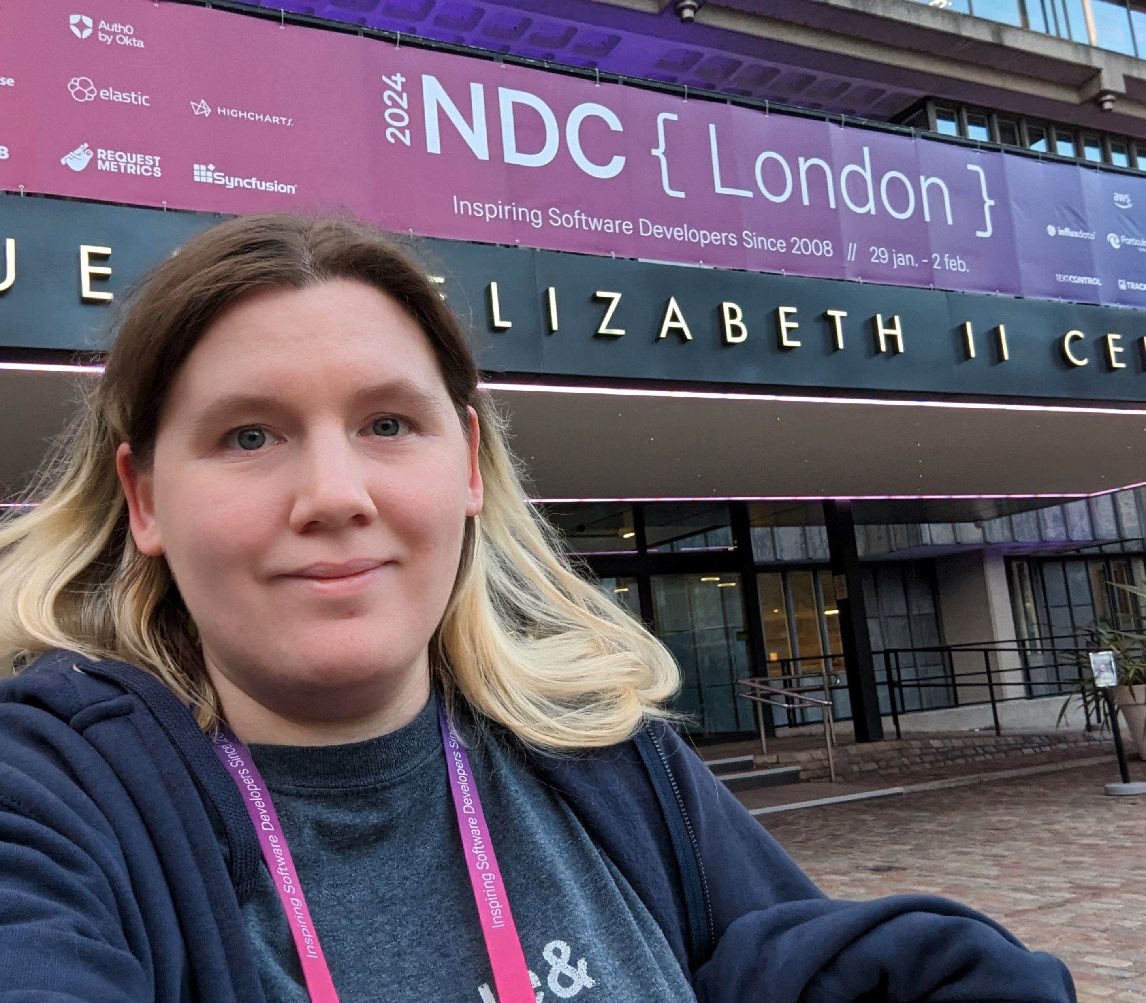
My Background
Spina Bifida, Scoliosis, and effectively a chapter out of the DSM-5.
DHS Trusted Tester
American Printing House for the Blind
GoodMaps
Accessibility Engineer
International Speaker
Erissa

Slide 6

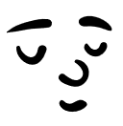
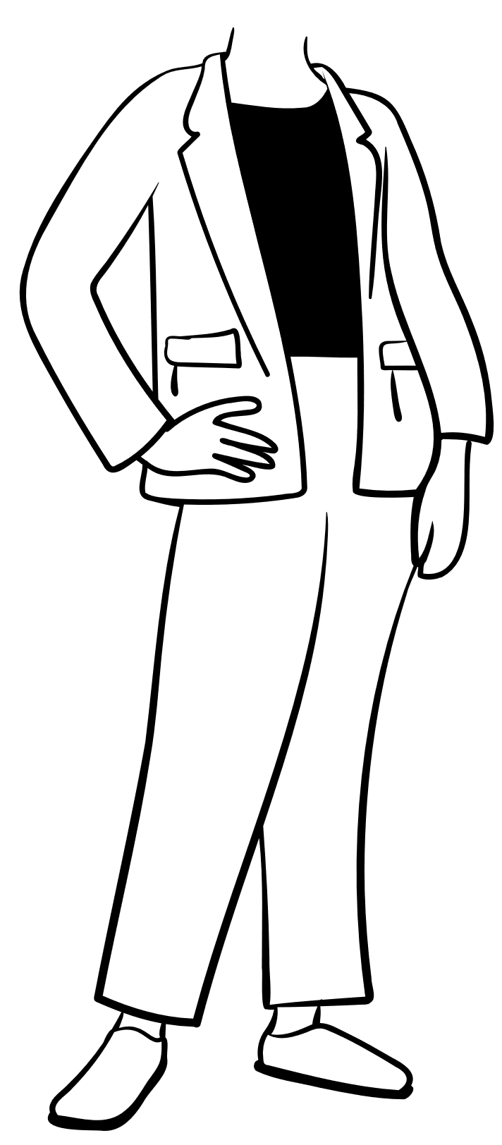
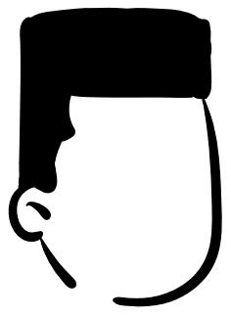
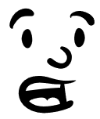
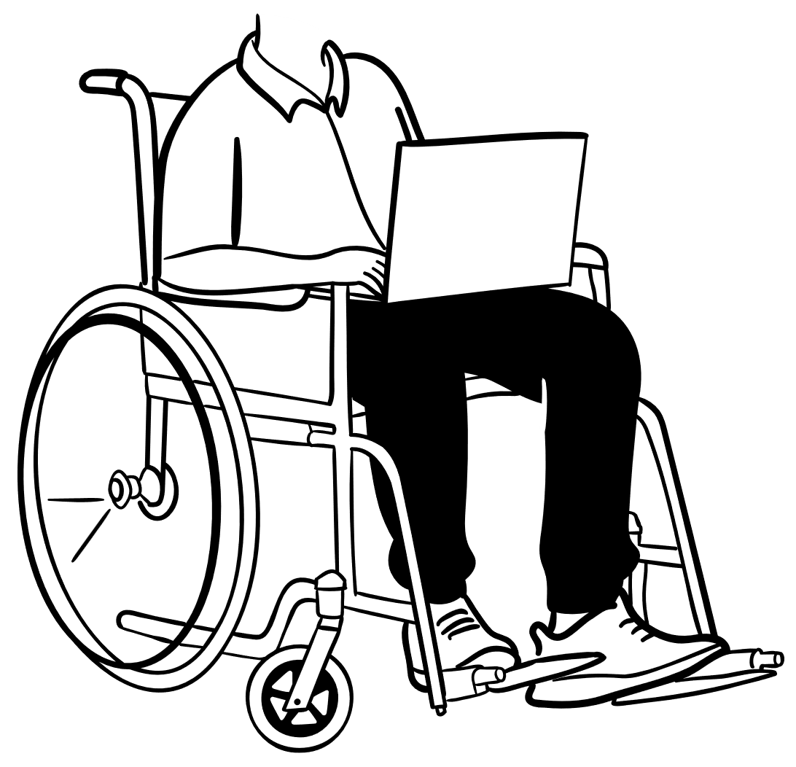
Networking
Erissa
Notes:
Neurodivergent is typically the word we see used when people are discussing someone on the autism spectrum, or whose brain just processes things differently from the norm.
But there in lies the problem. The term has a tendency to be used in a more negative connotation.
It is often used to say there is this baseline of what we consider “normal” and you deviate from that.
It is often used to make some people feel like they don’t fit in, and that they can’t unless they act like everyone else.

Slide 7
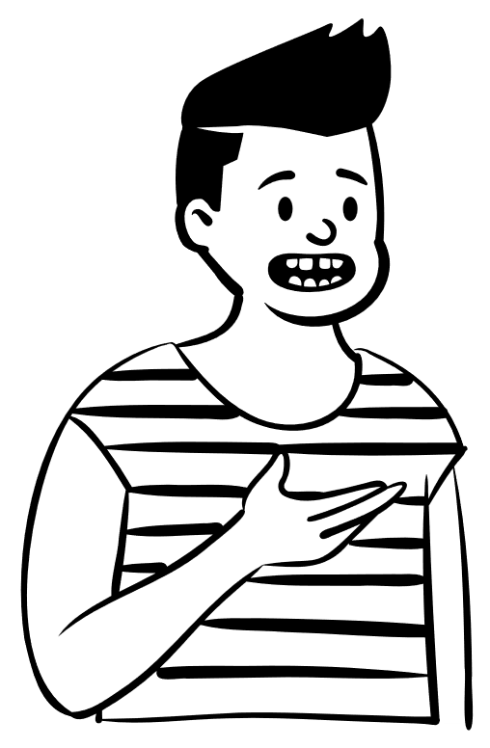
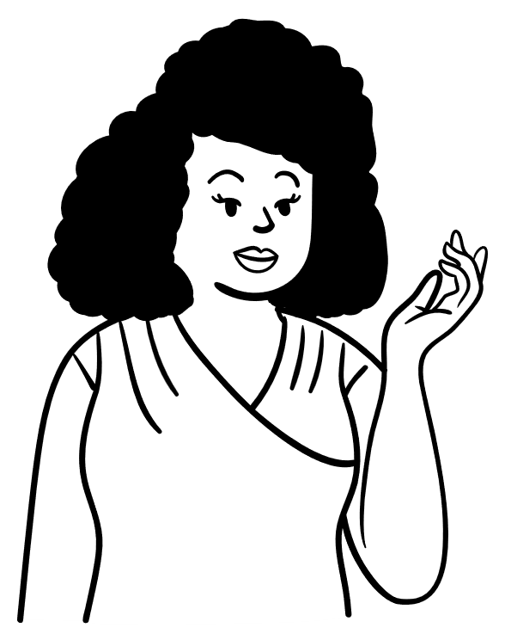
Networking
Erissa
Notes:
Neurodivergent is typically the word we see used when people are discussing someone on the autism spectrum, or whose brain just processes things differently from the norm.
But there in lies the problem. The term has a tendency to be used in a more negative connotation.
It is often used to say there is this baseline of what we consider “normal” and you deviate from that.
It is often used to make some people feel like they don’t fit in, and that they can’t unless they act like everyone else.

Slide 8
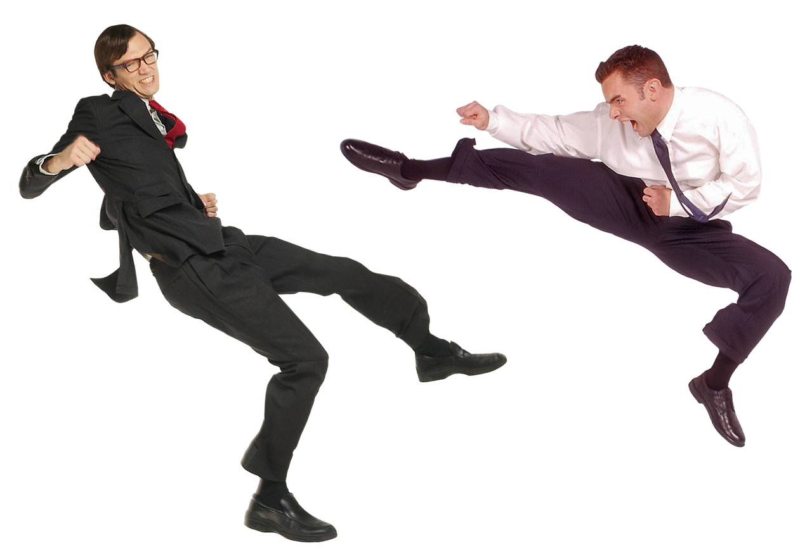
Networking Struggle
Networking
Me
Erissa
Notes:
Neurodivergent is typically the word we see used when people are discussing someone on the autism spectrum, or whose brain just processes things differently from the norm.
But there in lies the problem. The term has a tendency to be used in a more negative connotation.
It is often used to say there is this baseline of what we consider “normal” and you deviate from that.
It is often used to make some people feel like they don’t fit in, and that they can’t unless they act like everyone else.

Slide 9
Neurodivergent
Erissa
Notes:
Neurodivergent is typically the word we see used when people are discussing someone on the autism spectrum, or whose brain just processes things differently from the norm.
But there in lies the problem. The term tends to be used with more of a negative connotation.
It is often used to say there is this baseline of what we consider “normal” and you deviate from that.
It is often used to make some people feel like they don’t fit in, and that they can’t unless they act like everyone else.

Slide 10
Neurodiverse
Erissa
Notes:
That is why I prefer the term Neurodiverse, which refers more so the everyone because everyone is different in how they view the world around them.
Everyone has had different life experiences and their brains have developed different ways of processing information about what they see, hear, and experience in the world around them.

Slide 11
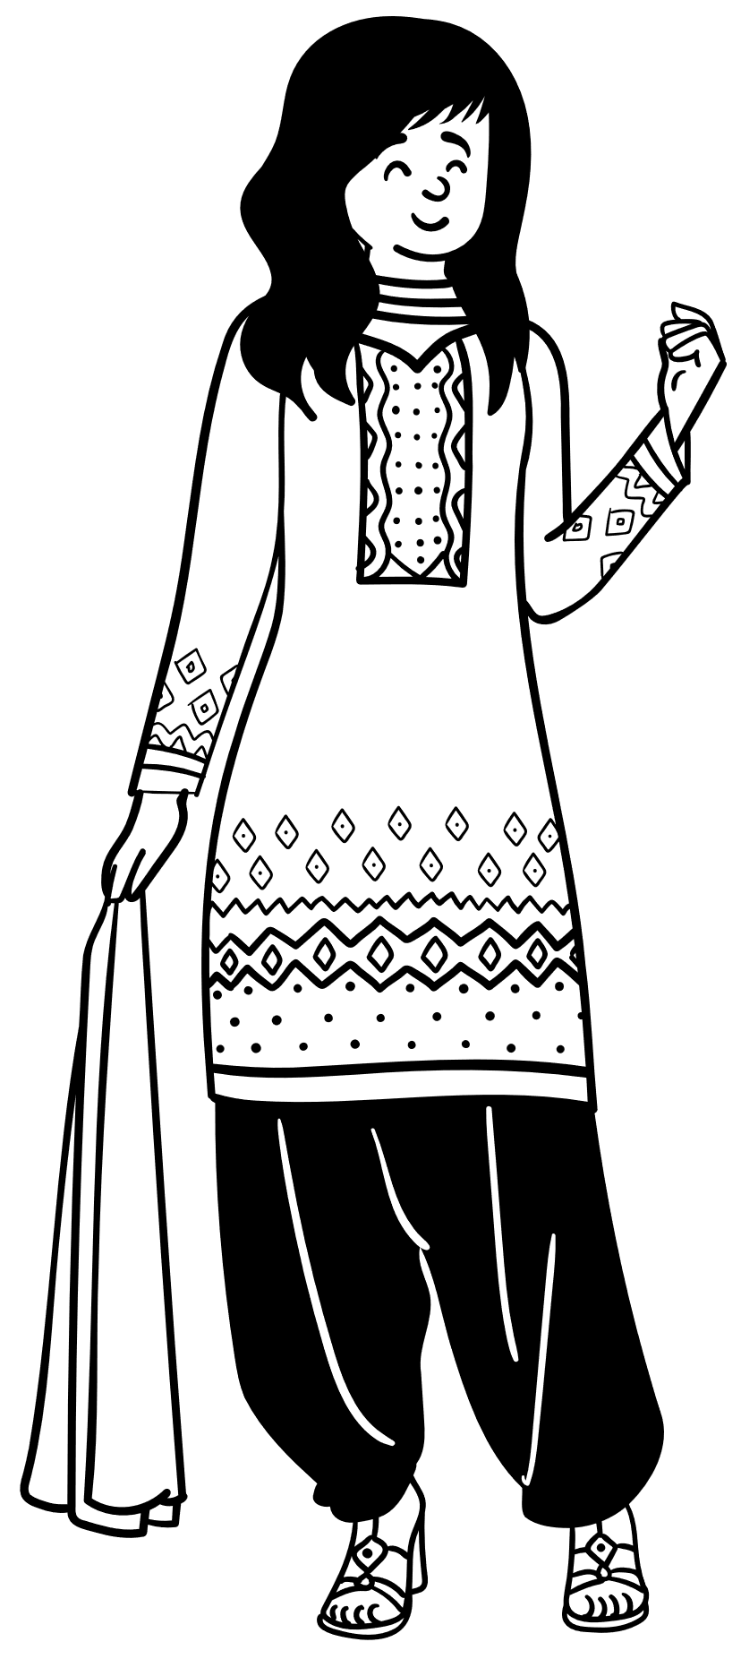
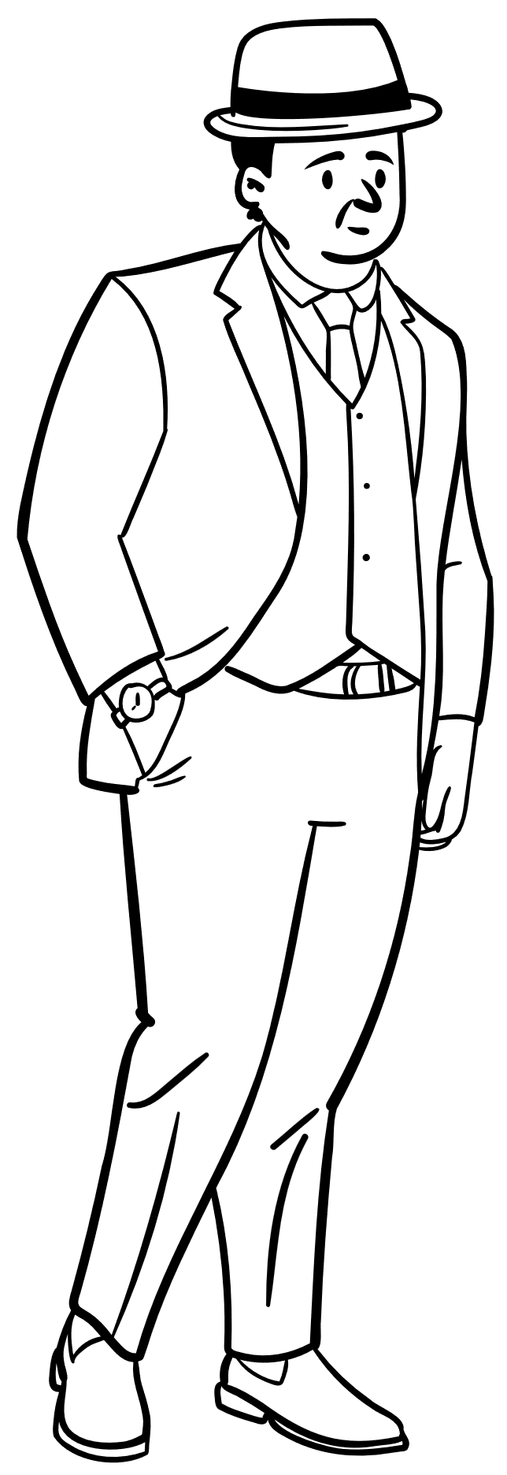
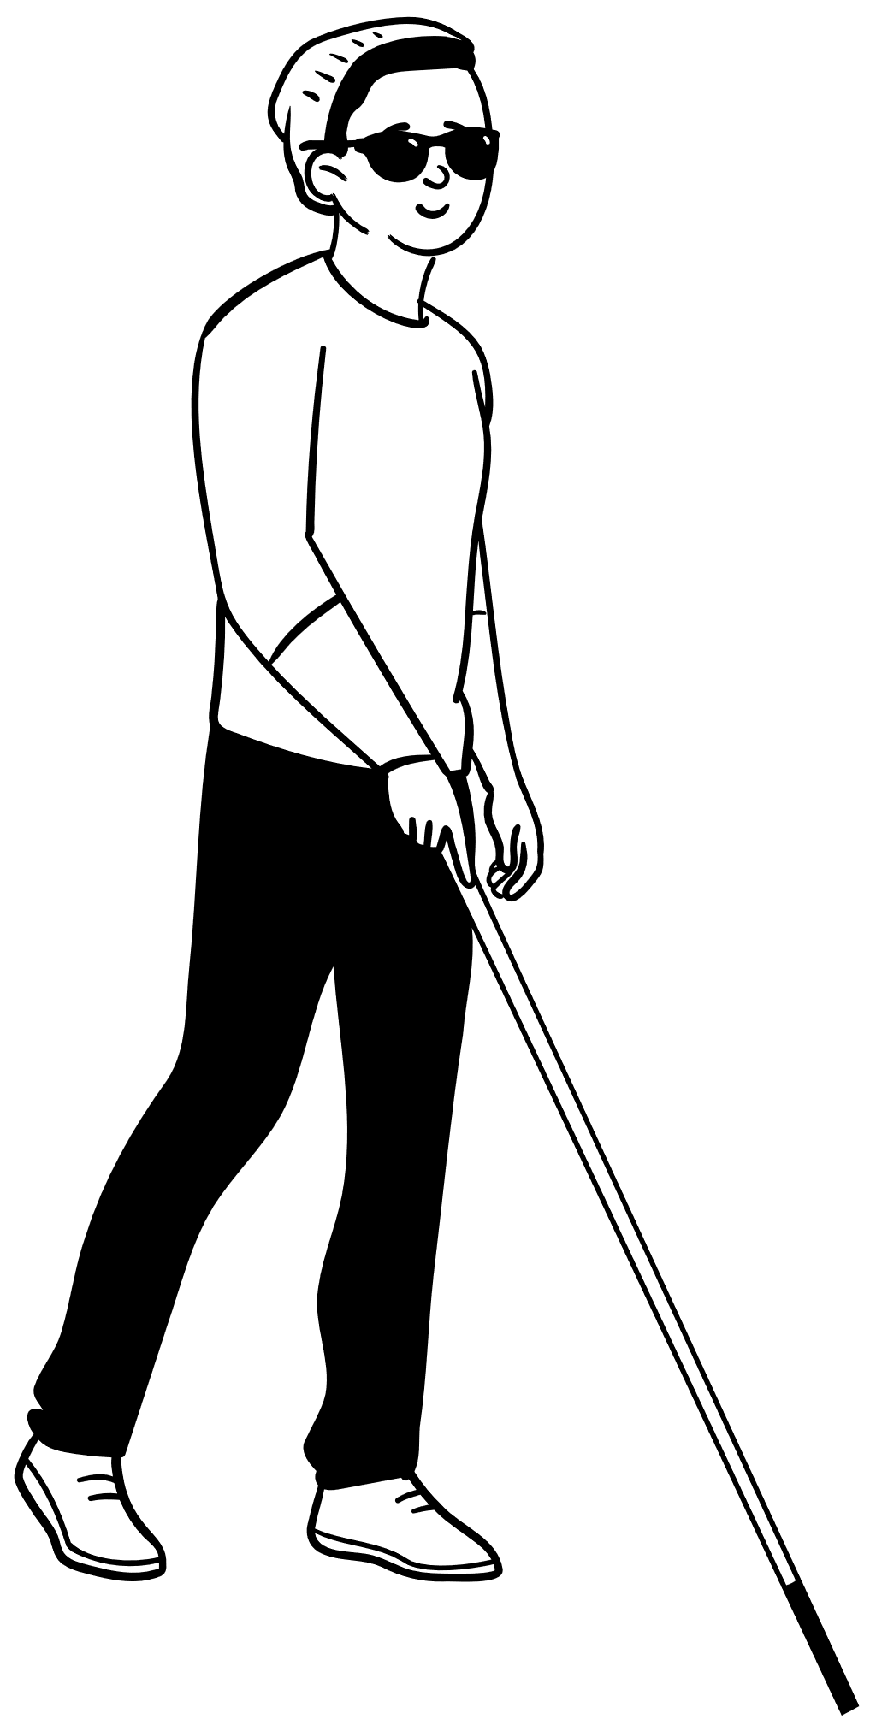
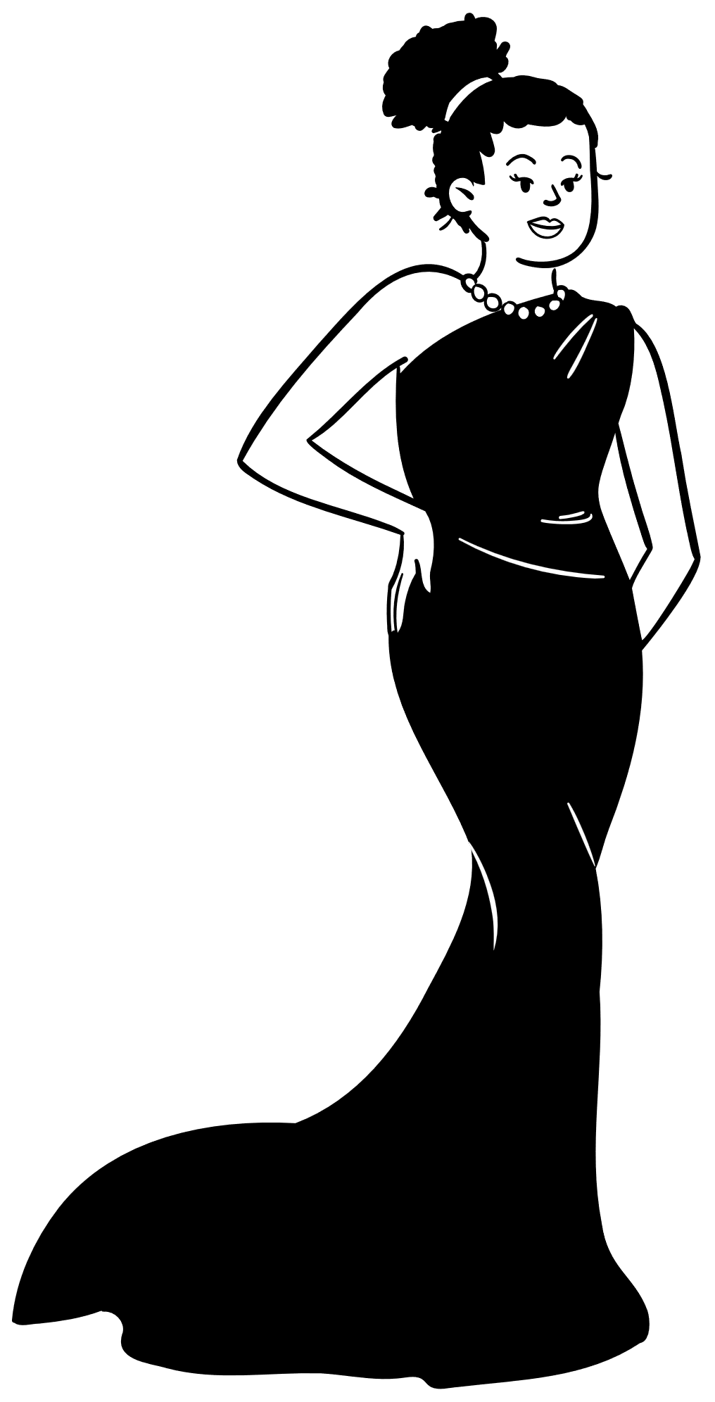
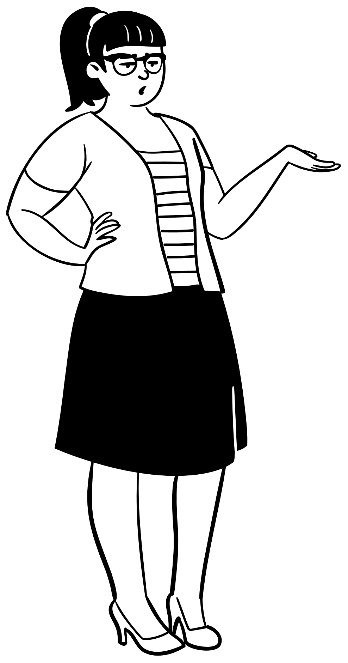
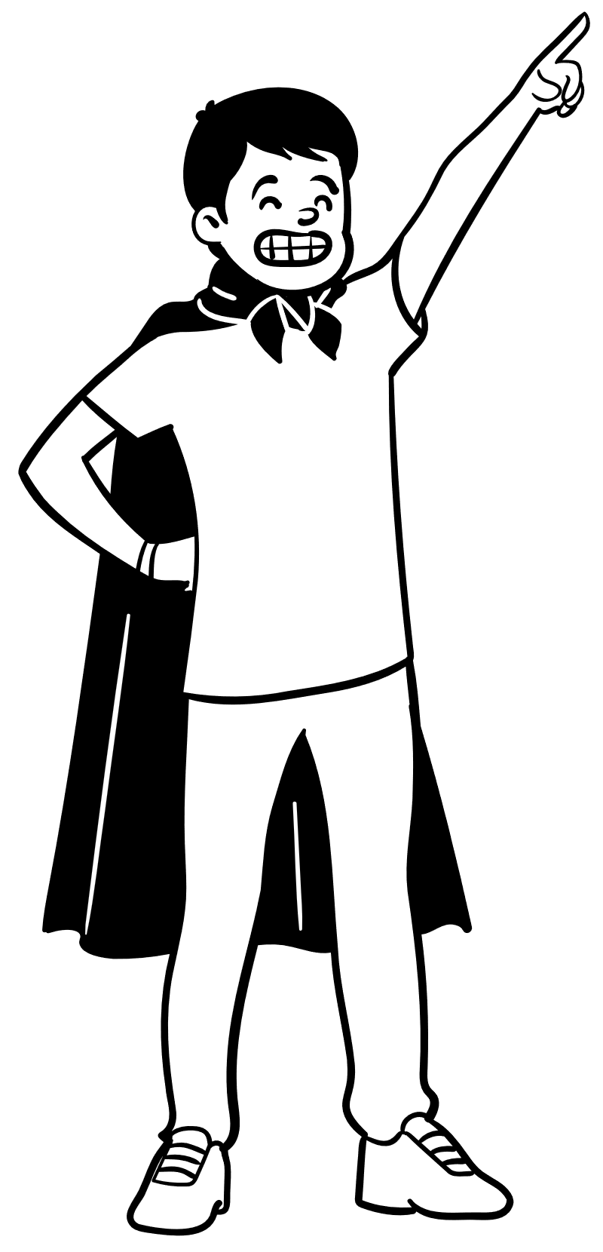
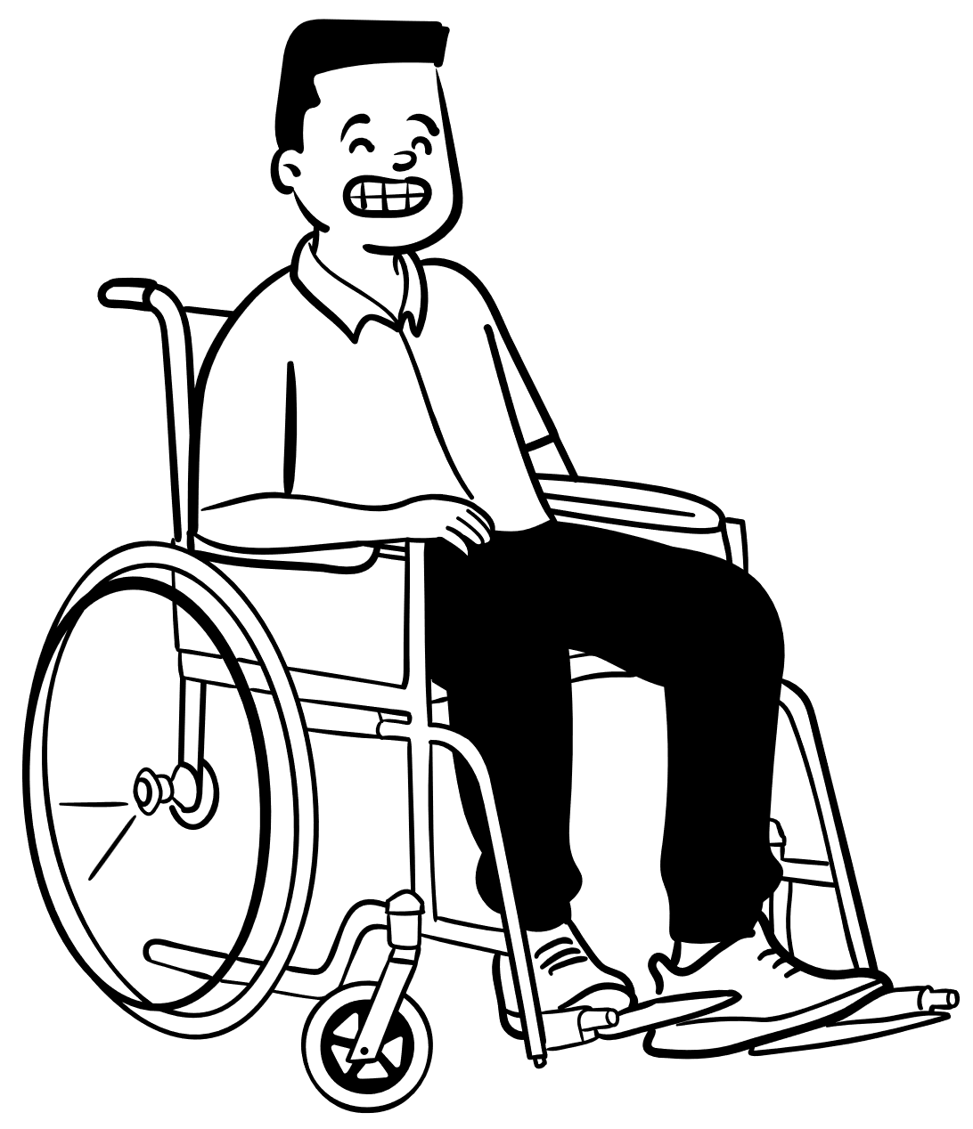
We aren’t all the same
Erissa
Notes:
We often get so caught up in trying to fit in and be like everyone else that we forget we aren’t all carbon copies of one another.
We all experience the world differently.
Have different lived experiences and ways our brains have developed to process the things around us that have shaped how we perceive and react to the world around us from minute to minute.
What works for one person doesn’t always work for the rest.
The way you are most productive isn’t necessarily the most productive method for someone else.
We get so caught up sometimes in trying to be like everyone else that we forget how to just be ourselves
Or even worse, we forget that it is okay to just be ourselves.
When we are trying to be someone else it is like being on alert every minute of the day.
If you ever worked retail, you’ve probably heard of the customer service voice.
You’ve probably felt the feeling of intense relief you get when you get home where you feel safe to drop the façade.
That feeling can happen when you try to network because you may be trying to put forth this particular look and impression that you think is what you MUST do to be accepted.

Slide 12
We are not all the same
Erissa
Notes:
We often get so caught up in trying to fit in and be like everyone else that we forget we aren’t all carbon copies of one another.

Slide 13
Experience & User Feedback
Erissa

Slide 14


Experience & User Feedback Continued
Erissa

Slide 15
Consistent Experience
POUR Principles
Keyboard & Screen Reader
Erissa

Slide 16
Structure & Relationships
Semantics
Landmarks
Best Practices
First rule of ARIA
Erissa

Slide 17
Tools
Bookmarklets
Extensions
Desktop Applications
Erissa

Slide 18
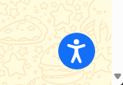
Accessibility Overlays
Check out https://overlayfactsheet.com/!
Decline

Slide 19
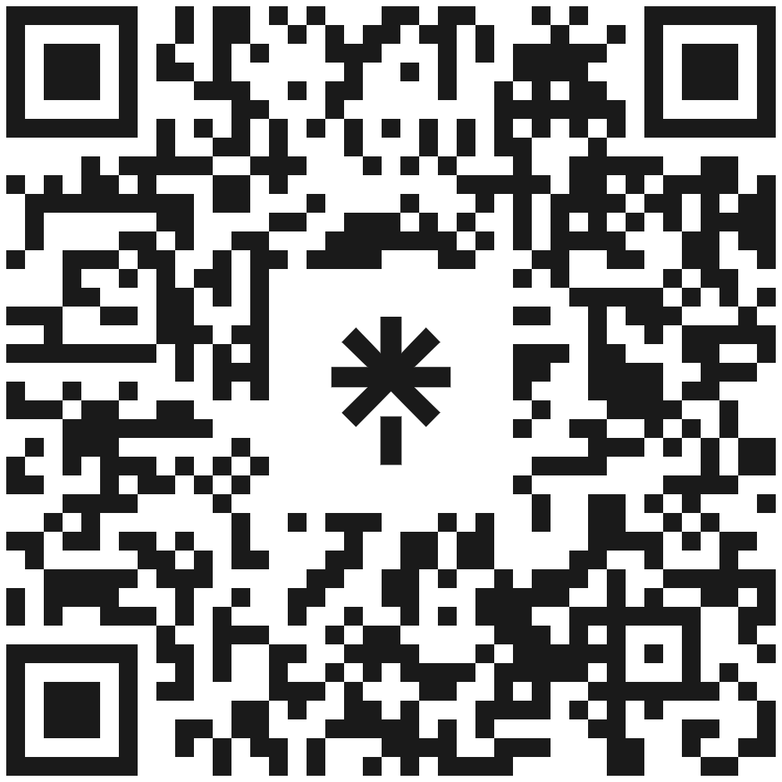
Thank you!
Erissa Duvall
www.Corgidev.com
linktr.ee/corgidev
Erissa

